Slide 1
Transformers Unit 10 Daniel Acuna acuna.io

Slide 2
Review of attention
The problem with this is that information that happened far in the past gets harder to be encoded in the state space

Slide 3
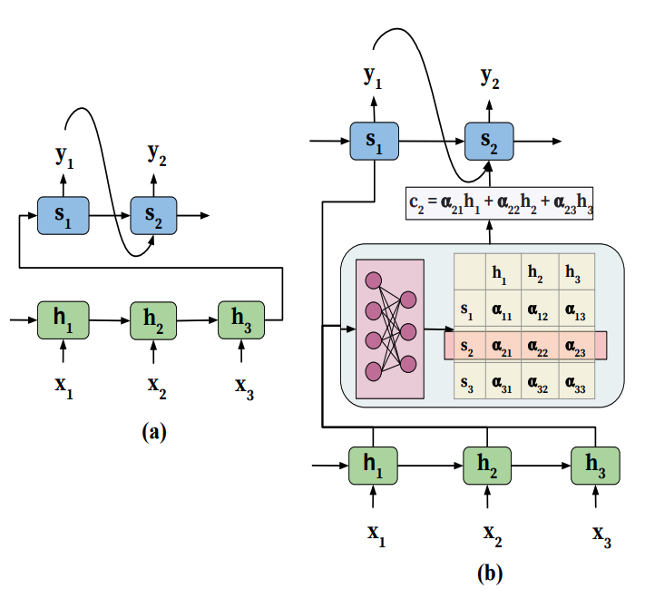
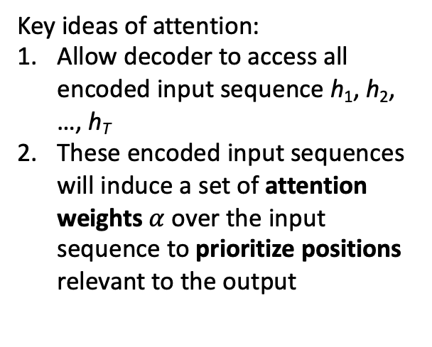
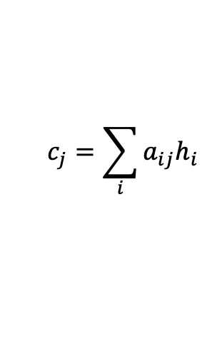
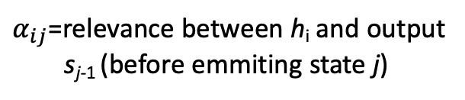
Attention model: context
Key ideas of attention:
Allow decoder to access all encoded input sequence h₁, h₂, …, h_{T}
These encoded input sequences will induce a set of attention weights $α$ over the input sequence to prioritize positions relevant to the output
$α_{ij}$=relevance between h_{i} and output s_{j-1} (before emmiting state j)
$$c_{j}=\sum_{i}{a_{ij}h_{i}}$$
context vector

Slide 4
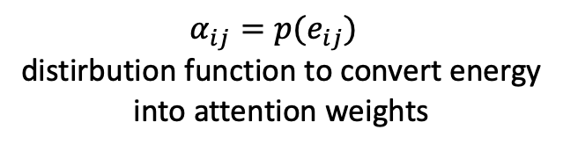
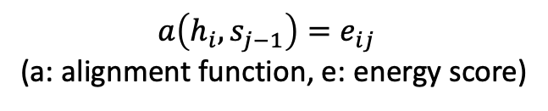
Attention model: attention learning
Attention weight learning: use additional feedforward network
$a\left(h_{i},s_{j−1}\right)=e_{ij}$
(a: alignment function, e: energy score)
$α_{ij}=p(e_{ij})$
distirbution function to convert energy into attention weights
Example functions for p?

Slide 5
Attention model: attention learning
Attention weight learning: use additional feedforward network
$a\left(h_{i},s_{j−1}\right)=e_{ij}$
(a: alignment function, e: energy score)
$α_{ij}=p(e_{ij})$
distirbution function to convert energy into attention weights
Because p and a are differentiable, we can learn those parameters

Slide 6
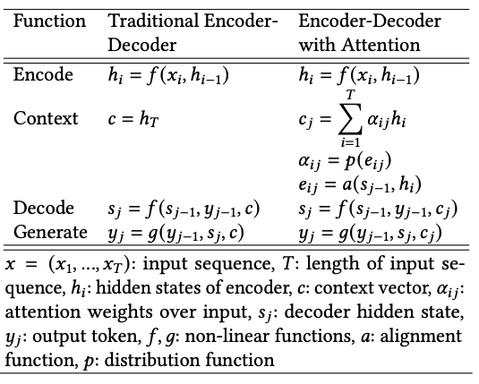
Attention model: math
(Chaudhari et al., 2021)

Slide 7
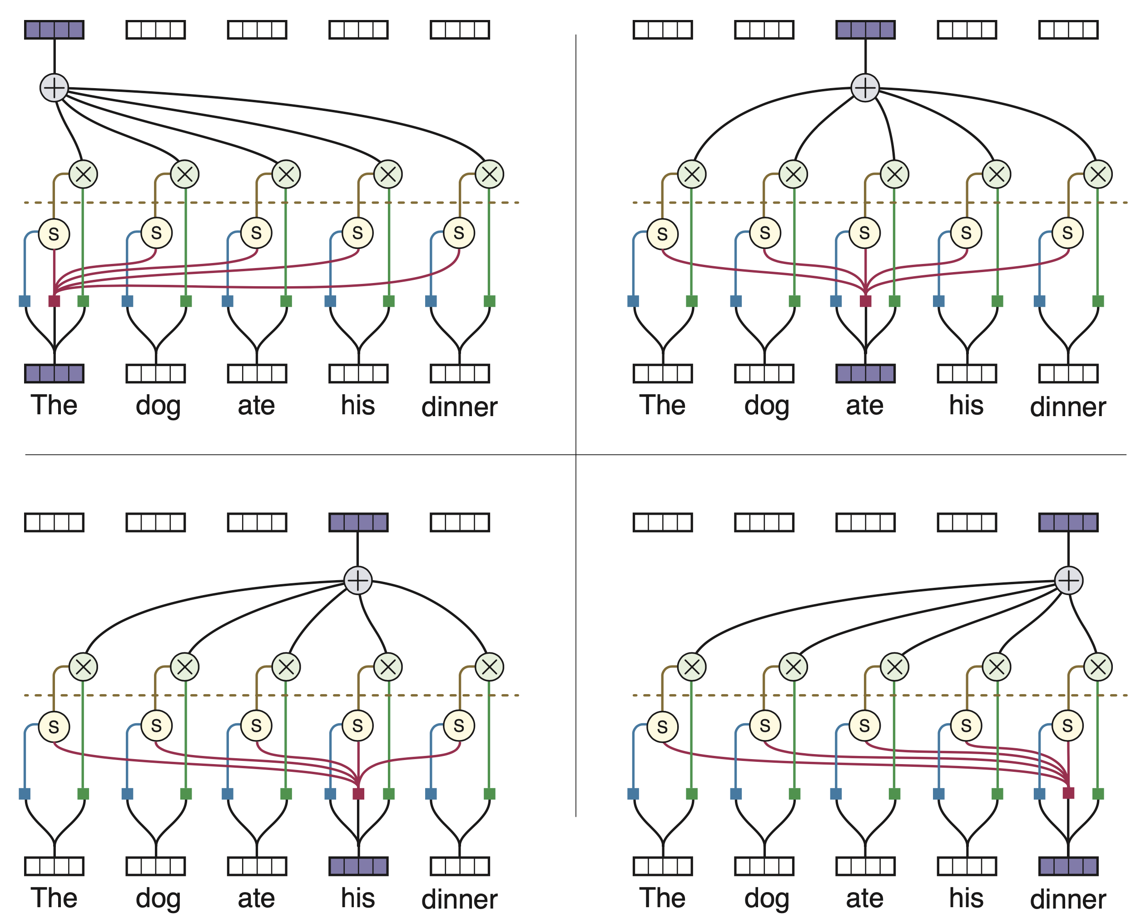
Self attention

Slide 8
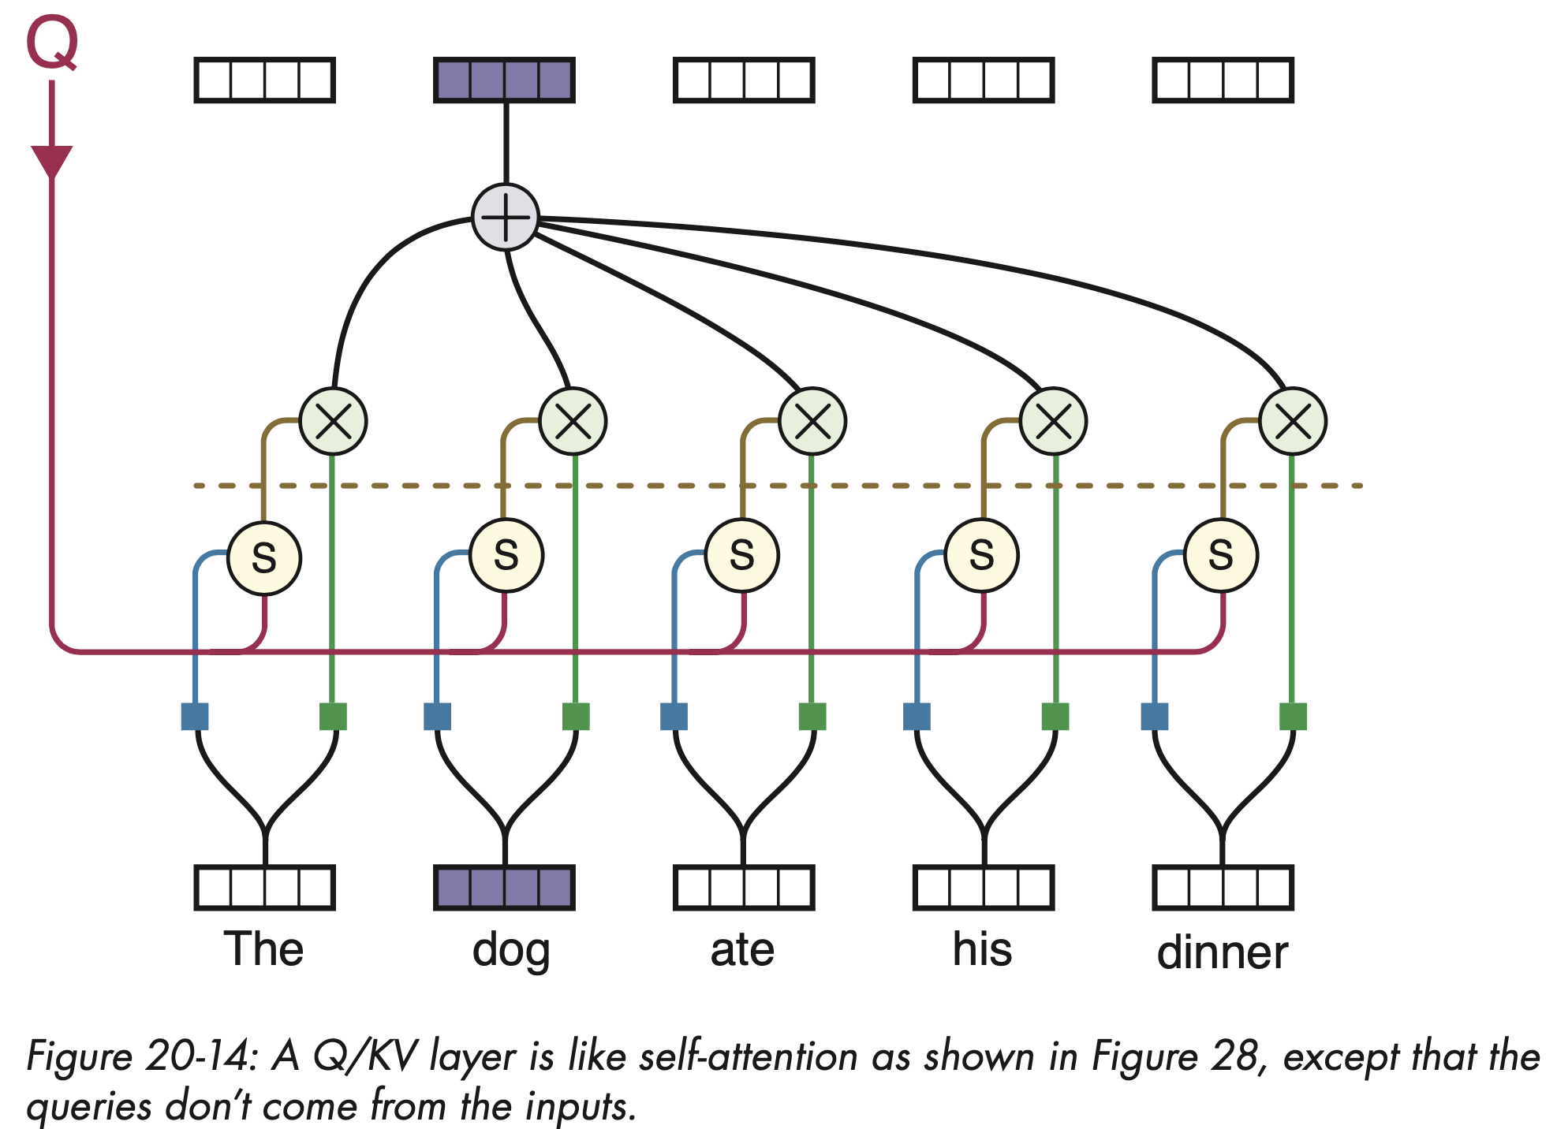
Q/KV attention

Slide 9
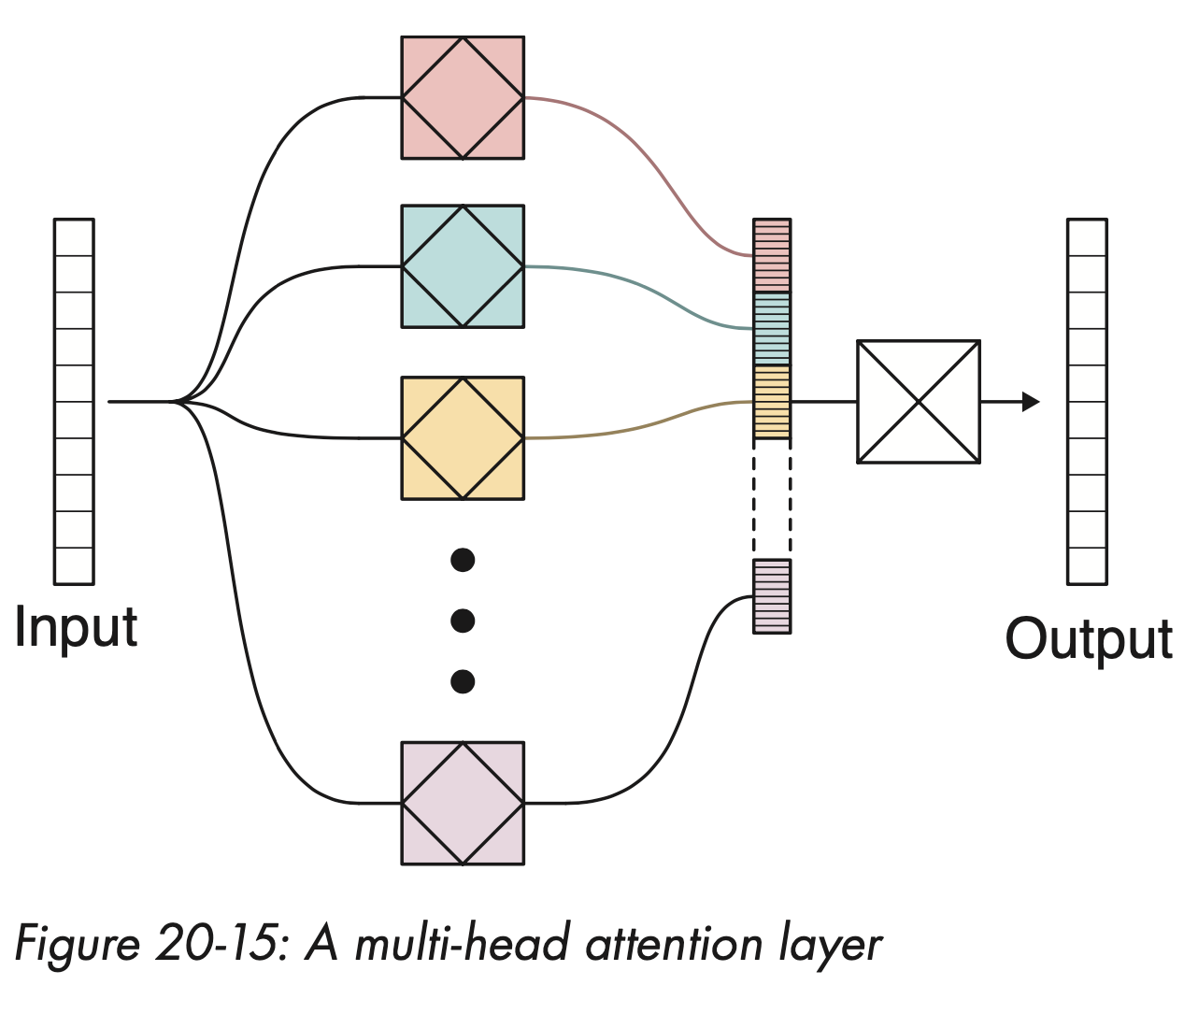
Multi-head attention

Slide 10
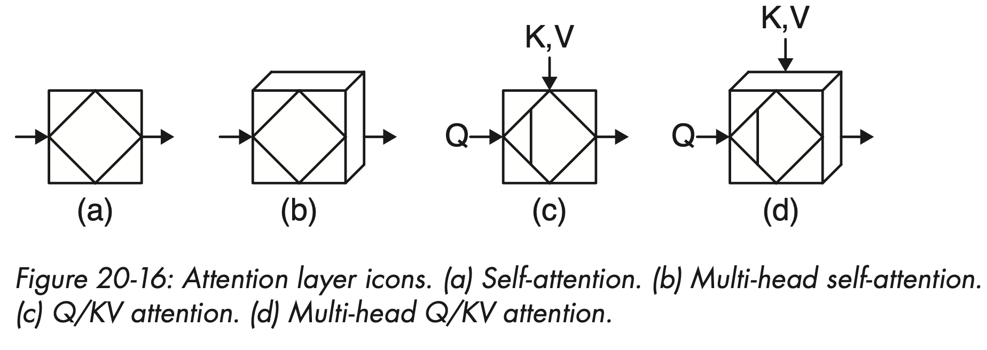
Notation in the book

Slide 11
Transformers: motivations
E.g., RNNs for translation are slow because we need to way for each word to be encoded/decoded
Hard to parallelize, takes time to train

Slide 12

Transformers
Completely rely on attention rather recurrence

Slide 13
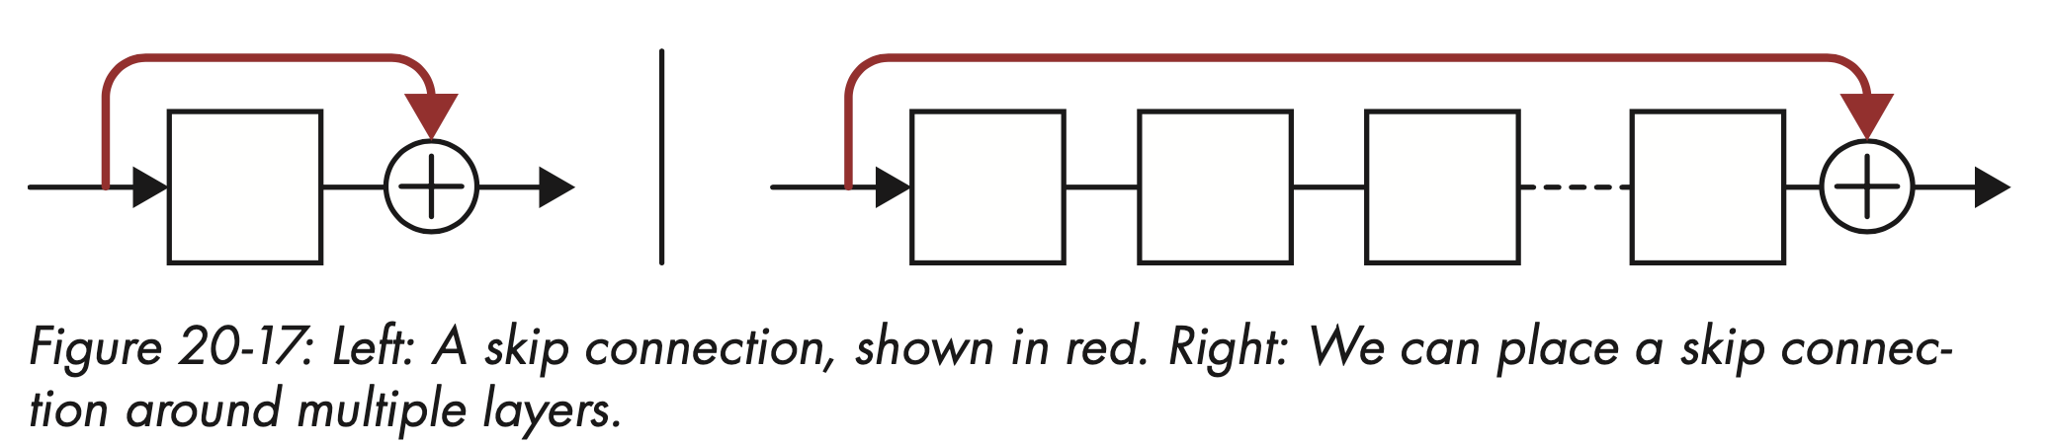
Skip connections
Skip connections
This is also called a residual connection because effectively
f(x) – x = r(x) => f(x) = x + r(x)
We can create deeper neural networks because the gradient doesn't degrade so fast

Slide 14
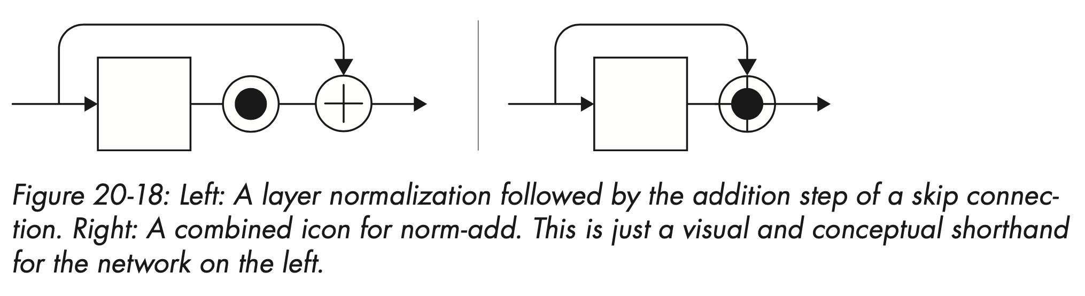
Normal-add
It is a form of regularization where values are kept as close to Normal as posible (mean 0 and standard dev = 1

Slide 15
Position encoding
By getting rid of RNN, we lose track of the position of our input. How can we encode the location?
The answer is to insert the position in each input as additioanl information.

Slide 16
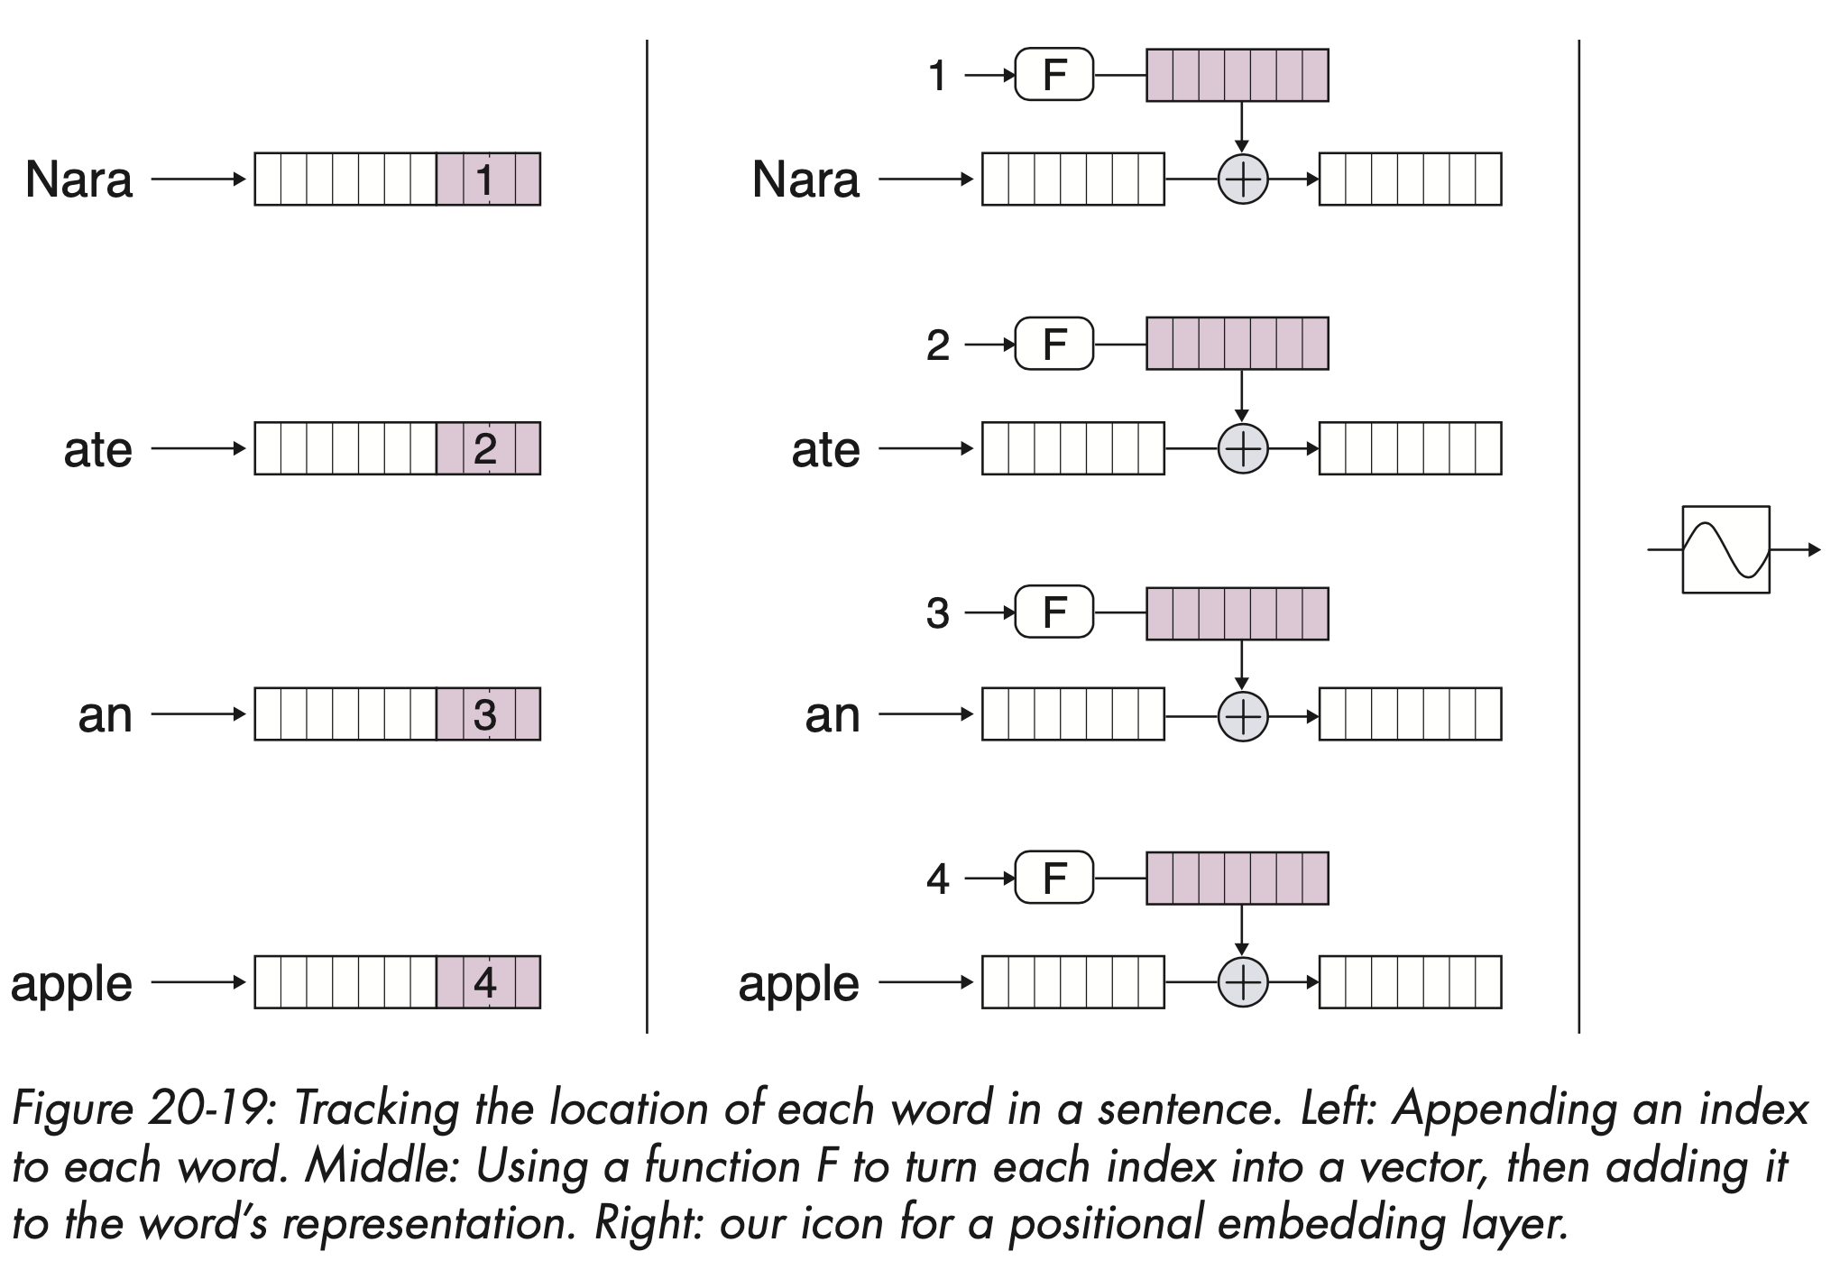
Positional encoding (2)

Slide 17
Positional encoding (3)
Even if we change the embedding itself, transformers can still learn to tell the position
We usually use functions that change a few bits of the data

Slide 18
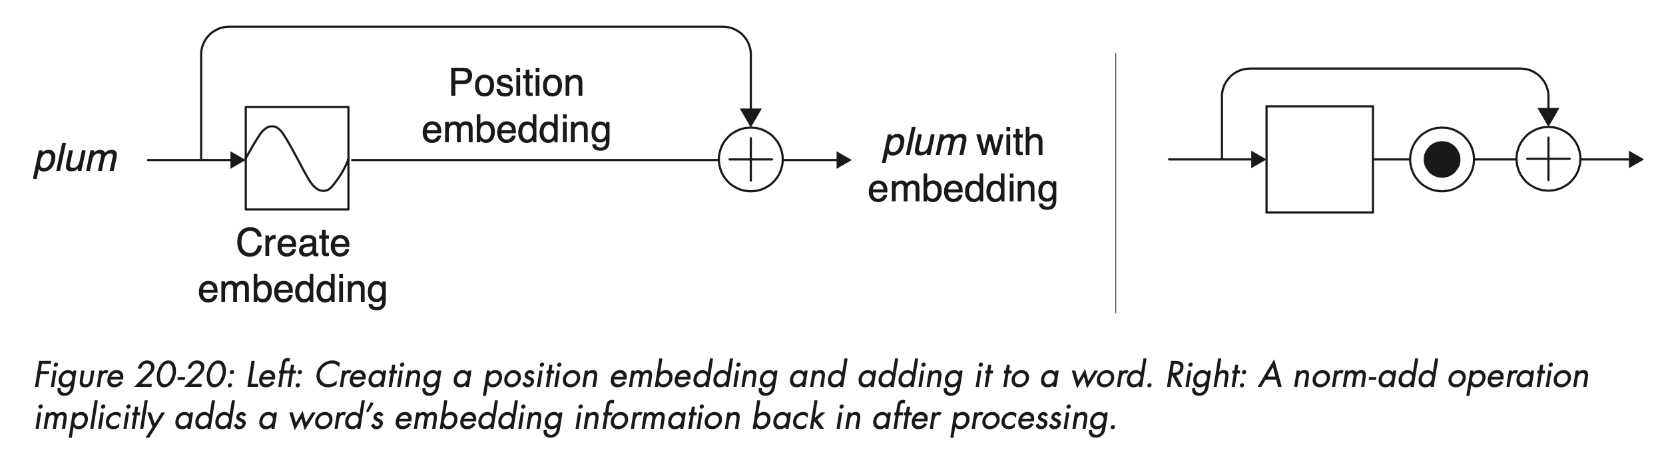
Positional encoding (3)
But how we make sure that the embedding doesn't get lost? We use skip connections

Slide 19
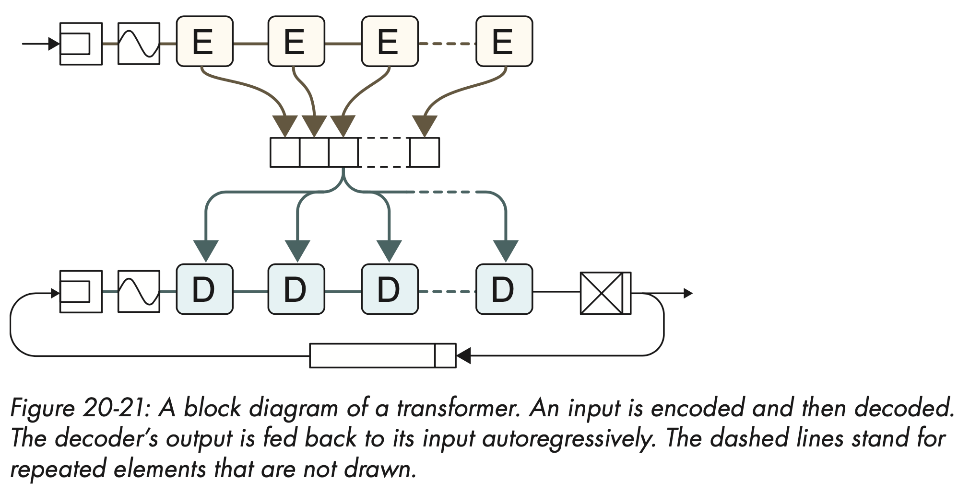
The transformer
- Blocks E and D are repeated sequences of layers, or blocks, built around attention layers
- Encoder accepts a sentence, and decoder accepts information from the encoder

Slide 20
The transformer
- Encoder and decoder begin with word embedding followed by position embeddings
- The decoded is autoregressive: it appends each output words to a growing list of outputs (box at bottom of figure)
- List becomes decoder input for next word

Slide 21
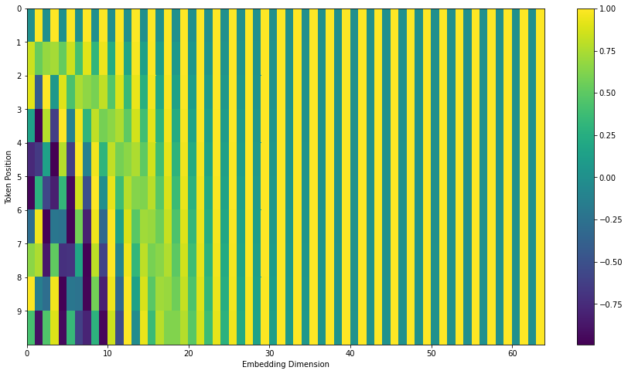
Positional encoding from paper

Slide 22
1x1 convolutions
Transformers or other language models use 1x1 convolutions to reduce the dimension of the data

Slide 23
1x1 convolutions
Transformers or other language models use 1x1 convolutions to reduce the dimension of the data
”Volume”
Size?
L: input length
H: Number of attention heads
E: Embedding size

Slide 24
1x1 convolutions
Transformers or other language models use 1x1 convolutions to reduce the dimension of the data
Apply filter
K filters of 1x1
Output dimensions?
”Volume”
(L*H)*(E)
Pass through embedding “depth”
L: input length
H: Number of attention heads
E: Embedding size

Slide 25
1x1 convolutions
Transformers or other language models use 1x1 convolutions to reduce the dimension of the data
Apply filter
K filters of 1x1
Output dimensions
(L*H)*K
”Volume”
(L*H)*(E)
Pass through embedding “depth”
when does this reduce dimensions?
L: input length
H: Number of attention heads
E: Embedding size

Slide 26
1x1 convolutions
Transformers or other language models use 1x1 convolutions to reduce the dimension of the data
Apply filter
K filters of 1x1
Output dimensions
(L*H)*K
”Volume”
(L*H)*(E)
Pass through embedding “depth”
(L*H)*(E) > (L*H)*K
L: input length
H: Number of attention heads
E: Embedding size

Slide 27
1x1 convolutions
Transformers or other language models use 1x1 convolutions to reduce the dimension of the data
Apply filter
K filters of 1x1
Output dimensions
(L*H)*K
”Volume”
(L*H)*(E)
Pass through embedding “depth”
(L*H)*(E) > (L*H)*K
L: input length
H: Number of attention heads
when
K < E
E: Embedding size

Slide 28
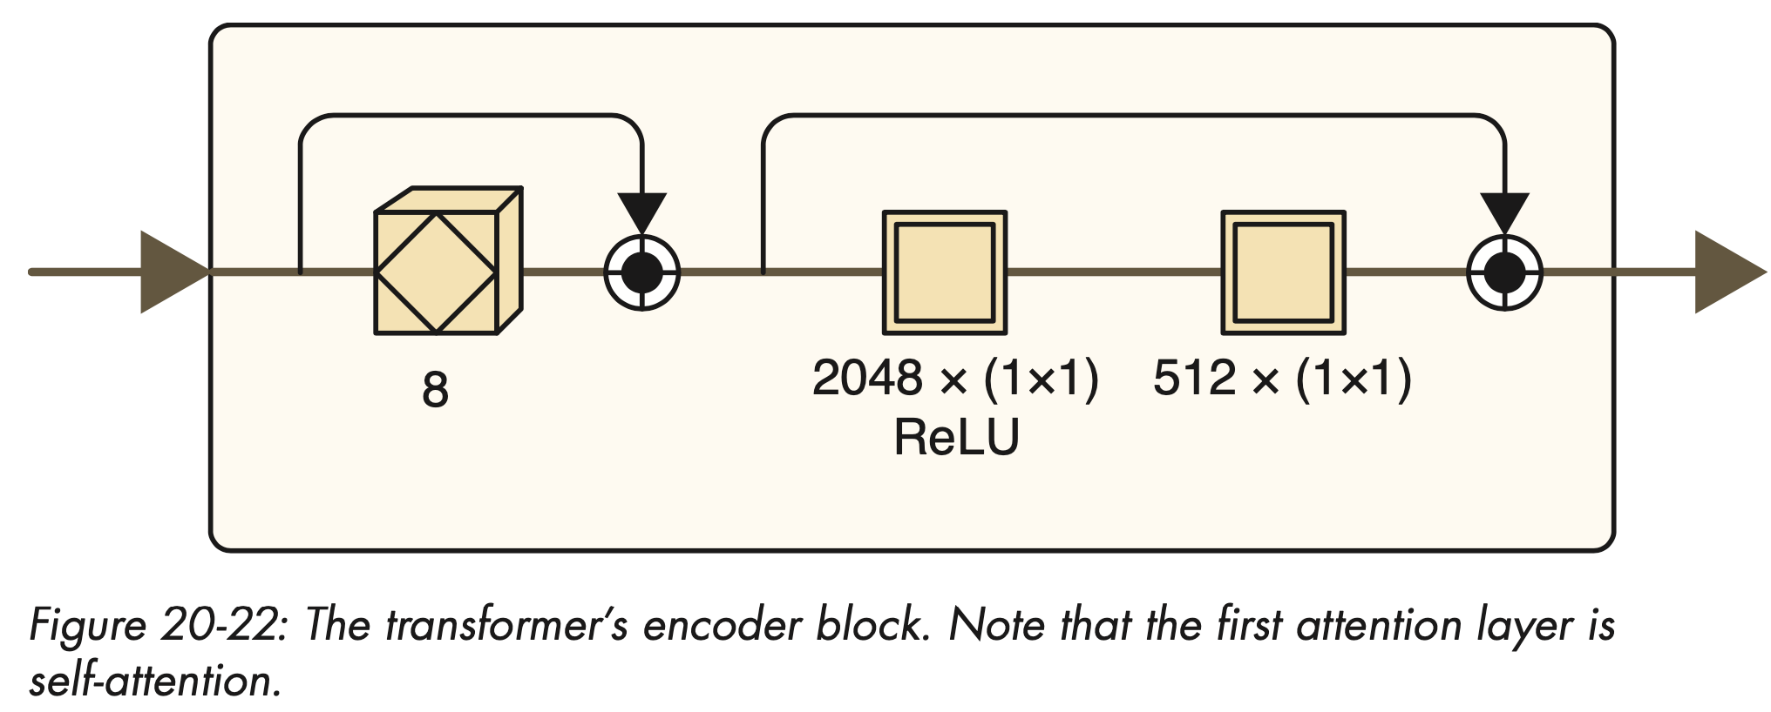
Encoder block
- First attention layer is self-attention
- Encoder begings with a layer of multi-head self-attention (8 heads)
- This layer goes through a norm-add skip connection to regularize-

Slide 29
Encoder block
- The second two layers are called pointwise feed-forward layers (terrible name)
- We can think of them as 1x1 convolutions
- They are wrapped in a norm-add skip connection

Slide 30
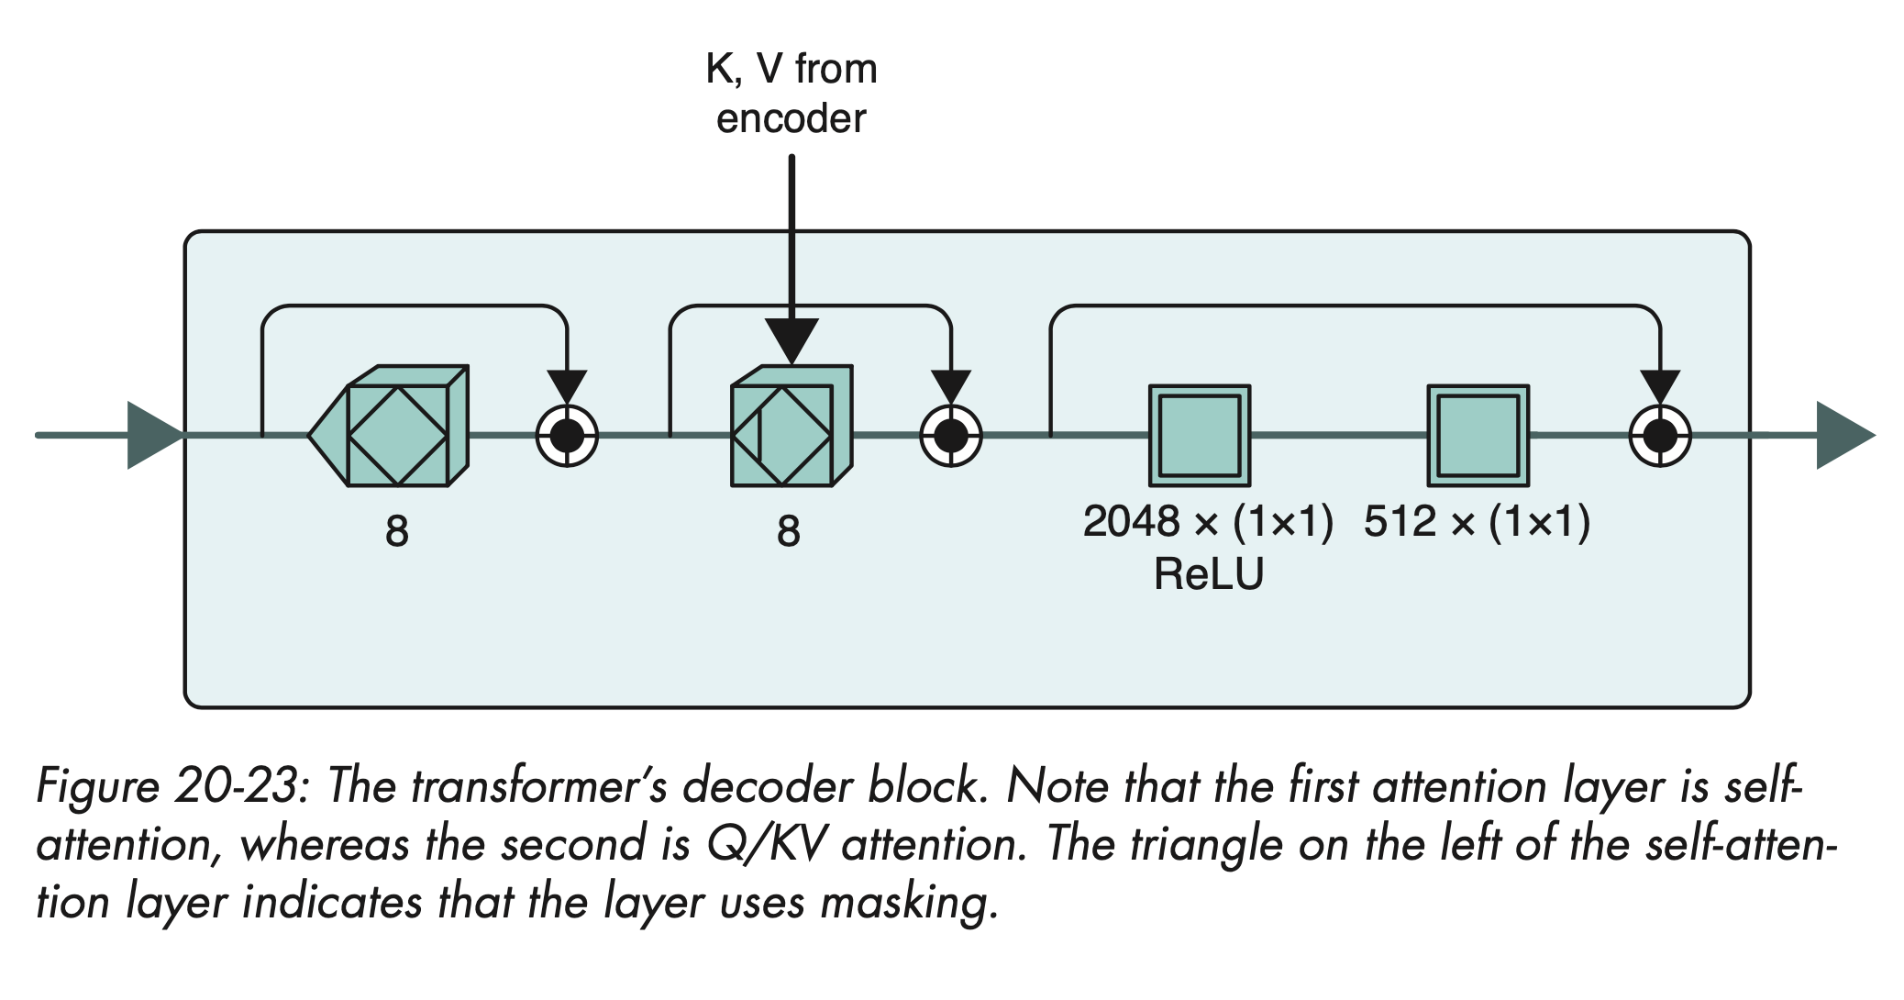
Decoder block
- First, we have a multi-head self-attention layer
- Input is all word outputs so far from the transformer
- At the beginning, this contains only the [START] token
-This first step will look at all input words and weigh them

Slide 31
Decoder block
The self attention is followed by a multi-head Q/KV attention layer
Query vectors come from the output of previous self-attention layer
Keys and values come from concatenation of all encoder blocks

Slide 32
Decoder block
Pair of 1x1 convolutions

Slide 33
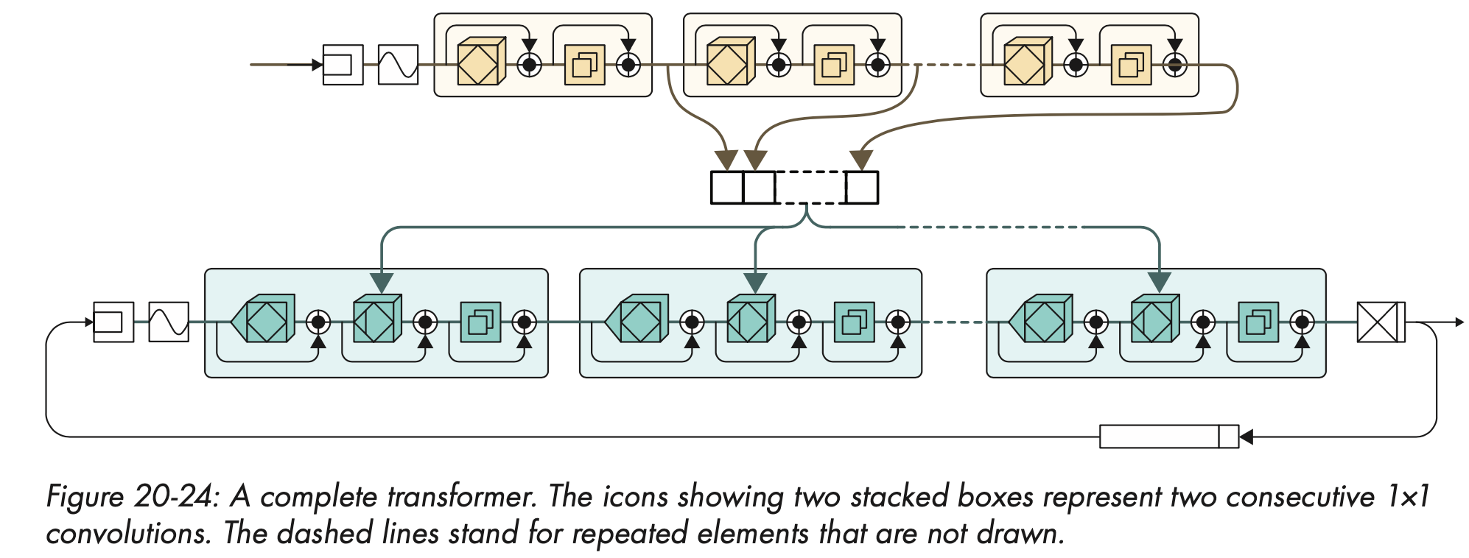
Putting it all together
Key insights:
Attention does not care whether input is 2 words or 500 words. It can run in parallel

Slide 34

The Original Transformer
The original transformer paper had 6 encoders and 6 decoders

Slide 35

Example
https://jalammar.github.io/illustrated-transformer/

Slide 36

Illustrated example
Huge credit to https://jalammar.github.io/illustrated-transformer/!

Slide 37
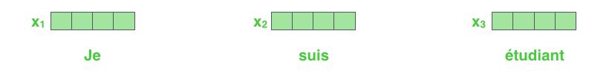
Step 1. Embed inputs
For example, embedding of size 512

Slide 38

Step 2. Self attention
We learn these matrices. In example, dimensionality of Q/KV (#columns) is smaller than embedding. Rows equal to (maximum) input length

Slide 39

Step 2. Self attention
Computing attention for the first word

Slide 40
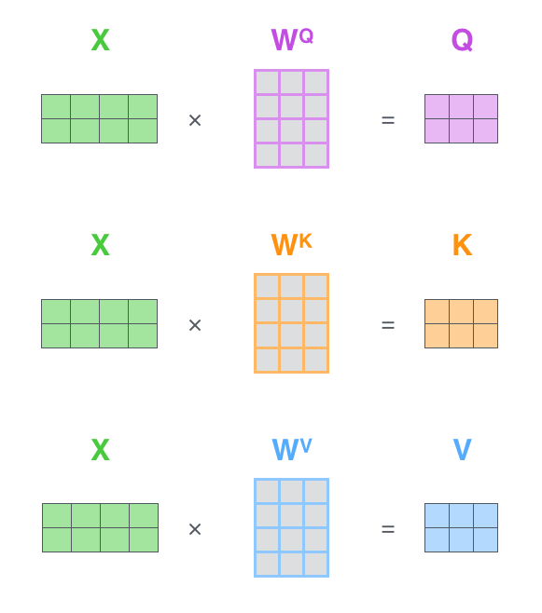
Step 2. Self attention
In matrix form, it is is easy

Slide 41

Step 3. Self-attention (2)
Alignment function known as scaled dot product. Scale is supposed to improve behavior of gradient

Slide 42
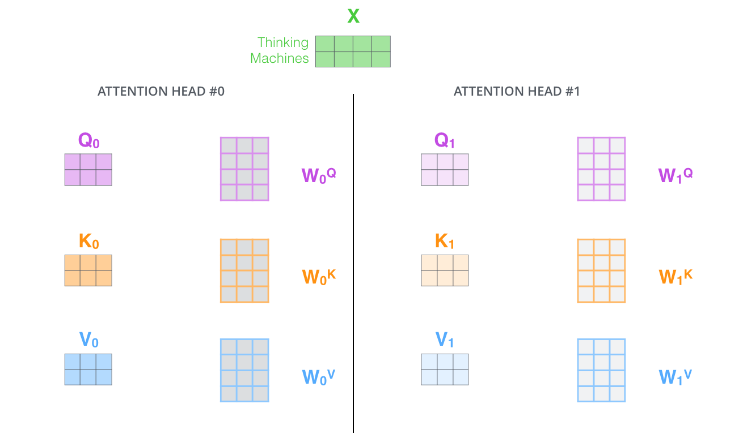
Step 3. With many heads

Slide 43
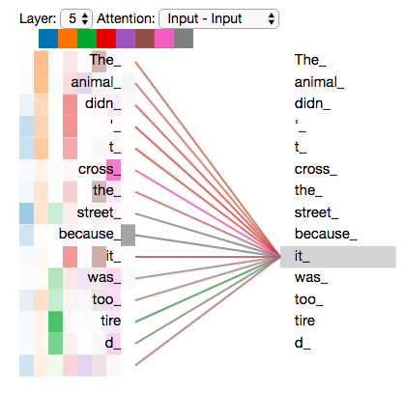
Example

Slide 44

Step 4. Pass through all encoders
Output of previous encoder is used as input to next encoder

Slide 45
Step 5. Decode
Masked multi-head self attention (“masks” inputs for predictions)

Slide 46
Animation

Slide 47
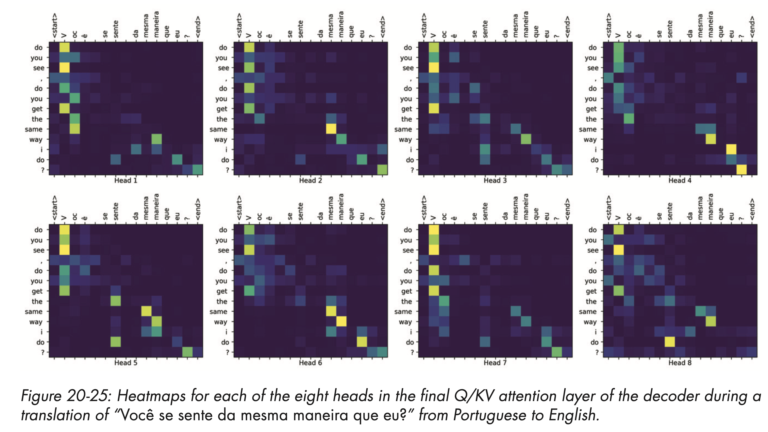
Example

Slide 48

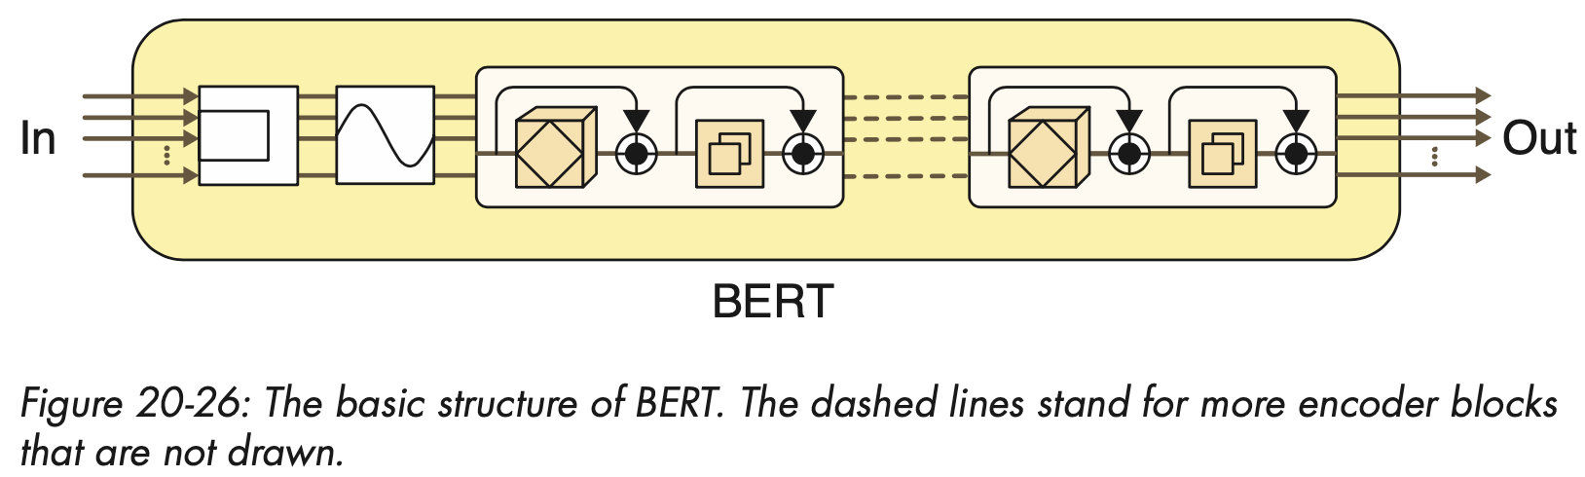
Applications
The general structure of the model can be used for many tasks
Bidirectional Encoder Representations from Transformers (BERT) (Devlin et al. 2019) is one such model

Slide 49
Applications: BERT
The general structure of the model can be used for many tasks
Bidirectional Encoder Representations from Transformers (BERT) (Devlin et al. 2019) is one such model
Entire architecture is based on encoders. Because of self-attention, it pays attention to both ways

Slide 50
Applications: BERT
BERT is a “large” model with 340 million parameters
It was trained on Wikipedia and 10,000 books
It was trained on two tasks
Next sentence prediction: give two sentences at once separated by a special token and determine whether they go together
Cloze task: predict word missing in a masked sentence

Slide 51
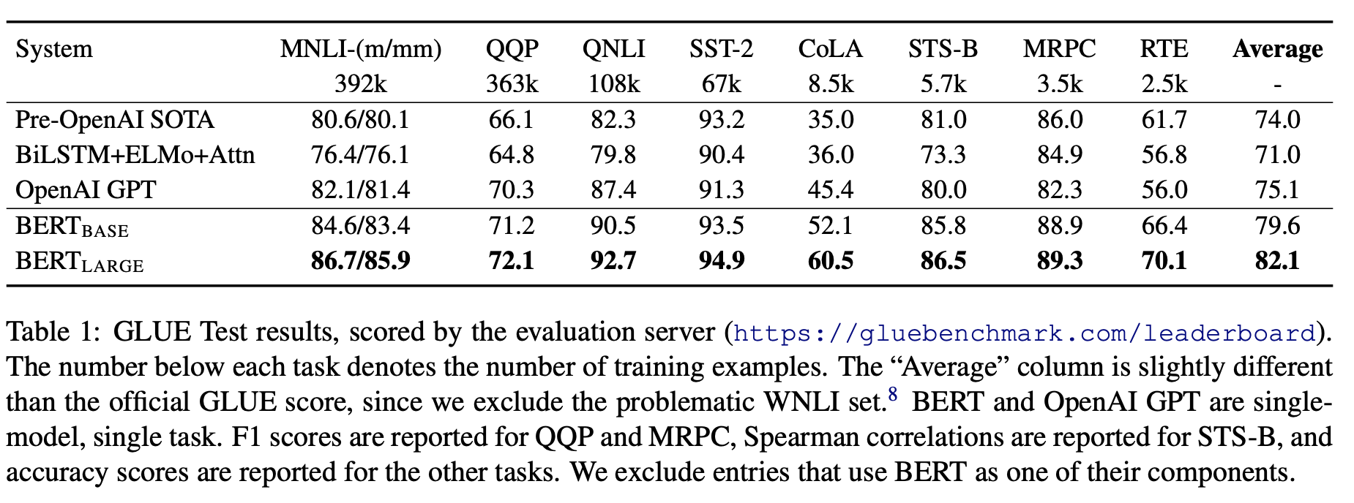
Applications: BERT

Slide 52
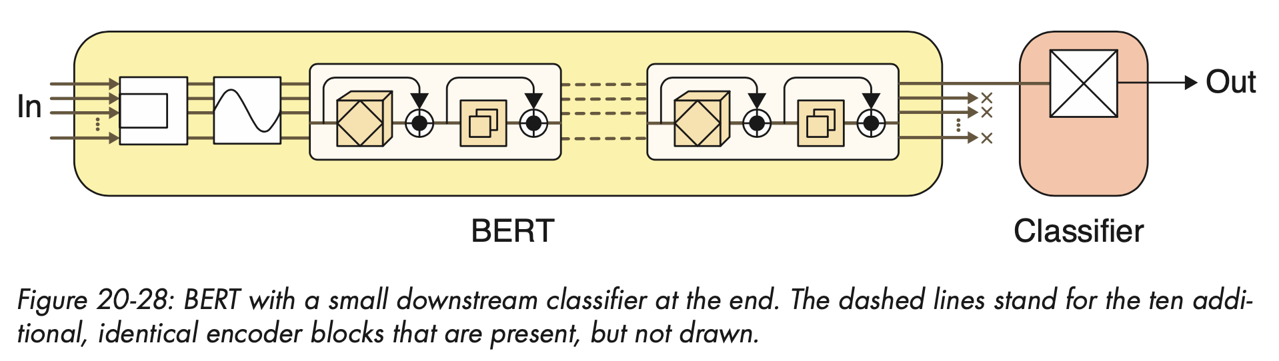
Transfer learning with BERT
Activity #1
https://colab.research.google.com/github/daniel-acuna/applied_deep_learning/blob/master/Transformers/sentiment_analysis_with_BERT.ipynb

Slide 53
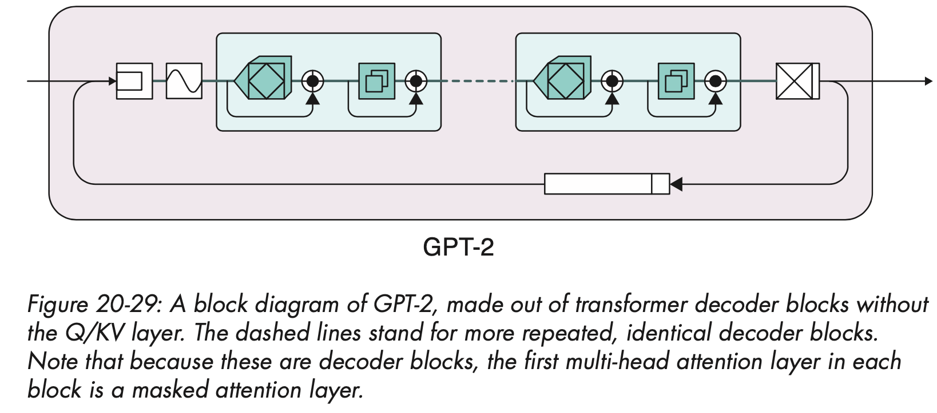
GPT-2
We can use a sequence of decoder blocks to generate new text
We only have decoder, and therefore, we don’t have Q/KV multi-head
Generative Pre-training model 2 GPT-2 (Radford et al., 2019)

Slide 54
GPT-2 (2)
512 tokens as input through 48 decoder layers with 12 attention heads in each produces 1.5 billion parameters
GPT-3 has 2,048 tokens at a time, 96 decoder layers, 96 attention heads in each layer: 175 billion parameters (Brown et al., 2020)
Training GPT-3 would take 355 GPU years and cost US$4.6 million

Slide 55
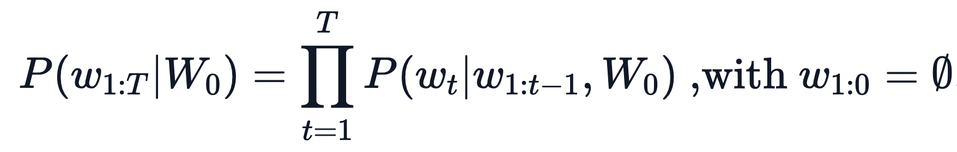
The meaning of life: revisited
Text generation: we want to find w[1:t] to maximize
But this is too complicated (exponential space)
https://huggingface.co/blog/how-to-generate

Slide 56
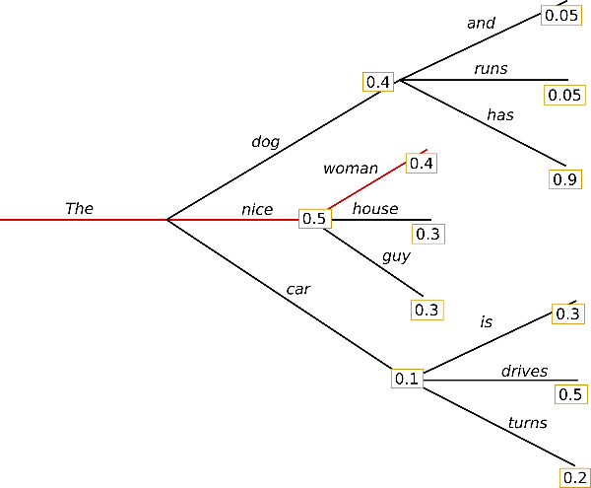
Text generation: greedy
Greedy search
https://huggingface.co/blog/how-to-generate

Slide 57
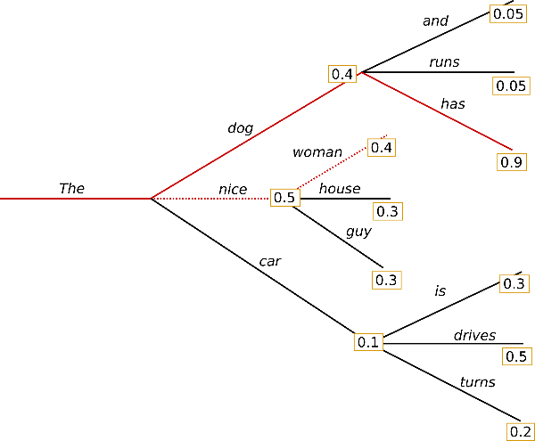
Text generation: beam search
Beam search: keep some alternatives around
https://huggingface.co/blog/how-to-generate

Slide 58
Text generation: sampling
Sampling: we could instead just sample from

Slide 59
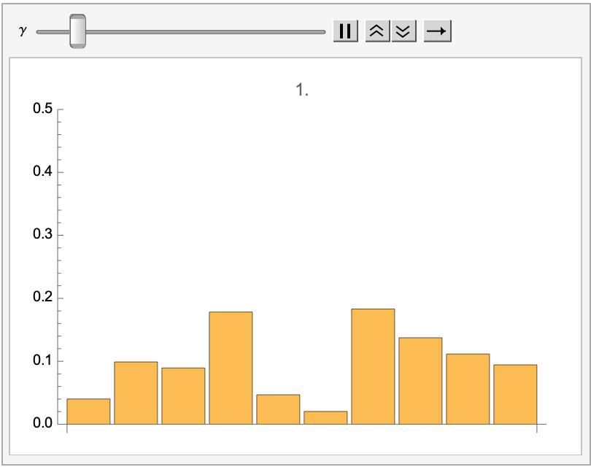
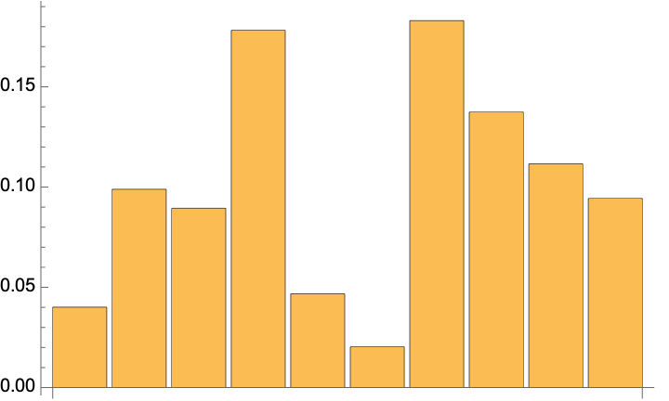
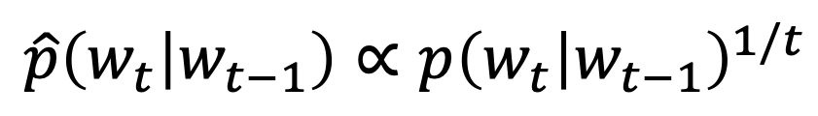
Text generation: sampling with temp
If we modify the probability as
$$\hat{p}\left(w_{t} | w_{t−1}\right)∝{p\left(w_{t} | w_{t−1}\right)}^{1/t}$$

Slide 60
What is the meaning of life?
Activity #2
https://colab.research.google.com/github/daniel-acuna/applied_deep_learning/blob/master/Transformers/GPT_2_text_generation.ipynb

Slide 61
Conclusion
Transformers have revolutionalized NLP
They are fast and can capture complex relationship between inputs and outputs
However, they have many more parameters compared to LSTM
They need vast datasets to be trained

